Slide 1
Project 1
Housing price in Houston Metropolitan areas
Did it soar with decrease of oil price along with/or unemployment?
Fabio Savorgnan
Javier Olivero
Sailendra Mahapatra

Slide 2
Project 1
Outlines:
Introduction Name
Acknowledgements Name
Data source and Methodology Name
Data Analysis
Crude oil price Name
Housing prices Name
Unemployment Name
Housing price trends vs Unemployment Name
Housing price trends vs Oil price Name
What does the analysis tell Name
Unemployment trends in different sectors Name
Concluding Remarks Name
Fabio Savorgnan
Javier Olivero
Sailendra Mahapatra

Slide 3
Project 1
Introduction:
Historically, oil prices rises and falls over time based on market demands, production quantities and geo-political scenarios, etc.
Does employment associated with this industry is affected by this rise and fall of oil prices ?
Does the sale values of houses fluctuate as per the employment scenarios (earning capacity) ?
In the present analysis, we analyze the above scenarios in the Houston Metropolitan counties
As we will see, through the course of this presentation, the oil price and housing price are not solely affected by oil price changes over a period of seven (7) years

Slide 4
Project 1
Acknowledgements:
We are thankful to our mentor/instructor Camden Kirk for his valuable guidance, valuable time and constant encouragement.
Thanks are due to our TAs and SSM for their time and help
Our sincere thanks to Trilogy and Rice University for conducting the Boot Camp and allowing us to learn and carry out the present analysis
We also thankful to our classmates who from time to time were of help in clearing our coding errors
Thanks are also due to Kaggle, Bureau of Labor Statistics …, Python/Lib developers for data and coding

Slide 5
Project 1
Data source & Methodology:
The data are retrieved through python coding from the below data sources.
Housing data – https://www.recenter.tamu.edu/data/housing-activity
Oil price – https://www.eia.gov/dnav/pet/pet_pri_spt_s1_m.htm
Unemployment rate – https://www.recenter.tamu.edu/data/employment/
As an initial attempt, we attempted the analysis to include all the 50+ Texas counties located in the Permian basin
However, as per data availability and time constraint, we confine our analysis to five (5) counties in the Houston Metropolitan areas
We use python coding to retrieve the data and utilized Pandas for creating relevant dataframes
The Maplotlib and Numpy libraries were utilized to create various plots

Slide 6
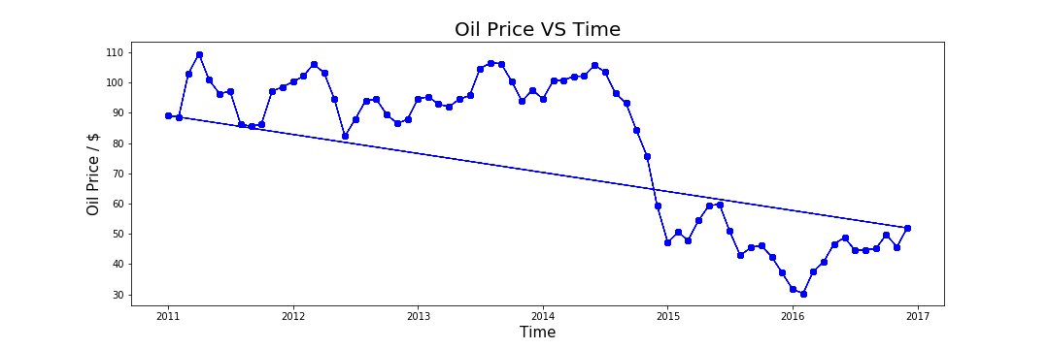
Project 1
Oil price remains over $90/bbl for most part of 2011 – mid 2014
It declines sharply to $48/bbl as it reaches year 2015

Slide 7
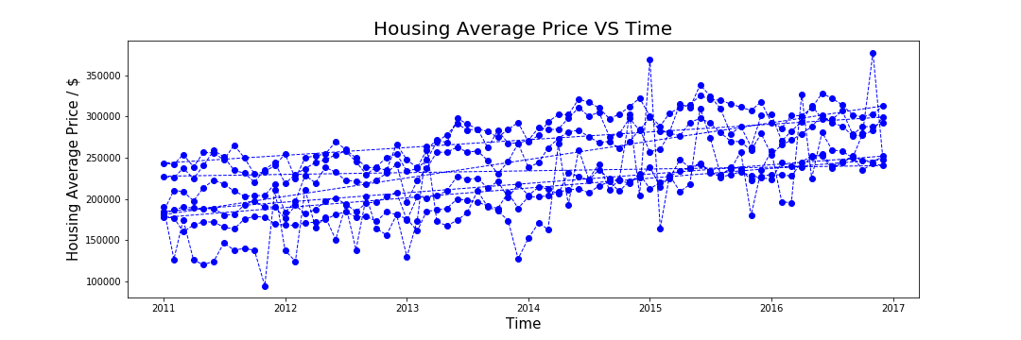
Project 1
Average housing prices per month are plotted
The cost over counties show a gradual increases from $250k to $335k from 2011 till 2017

Slide 8
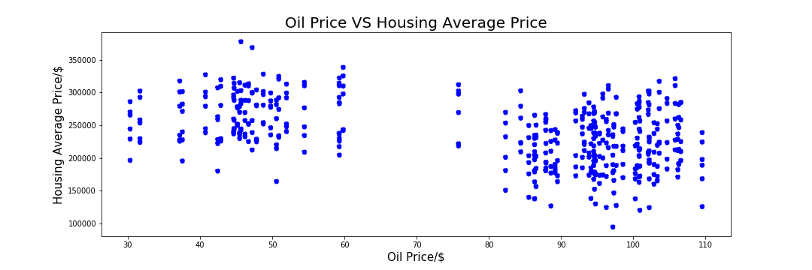
Project 1
Gap ???
The monthly average housing prices for the period changes very slightly
The gap in the middle corresponds to sudden drop of oil prices over the period

Slide 9
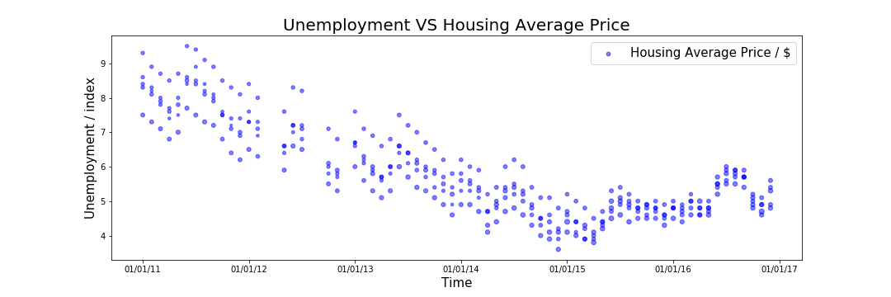
Project 1
Check Title / Y ??
The unemployment % for the period shows a gradual decrease with less than 4% in Dec 2014

Slide 10
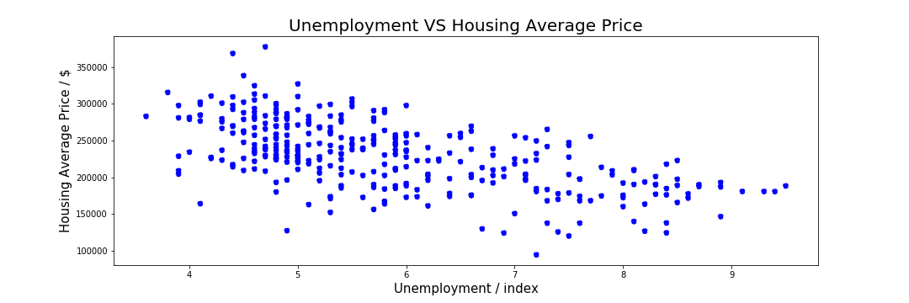
Project 1
Check X lebel ??
The monthly average housing prices for the period changes as the unemployment increases

Slide 11
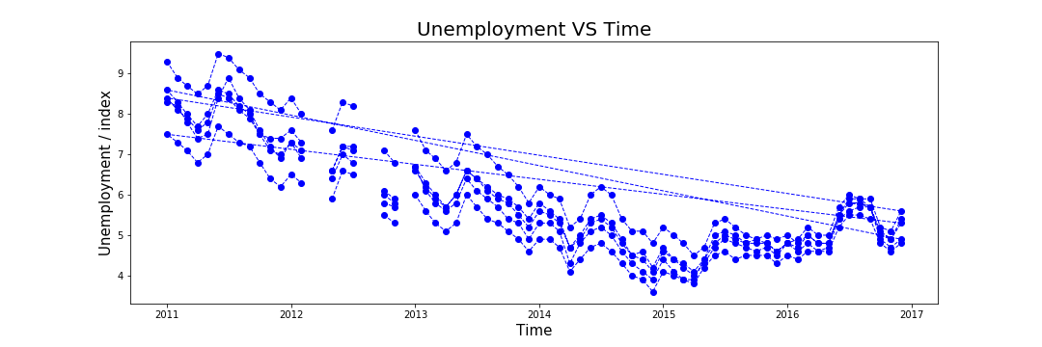
Project 1

Slide 12
Project 1
Gap ???
It tells us that the unemployment rate and housing price are mostly dependent
The oil price fluctuation does not show any corresponding change in housing price and unemployability over the counties

Slide 13
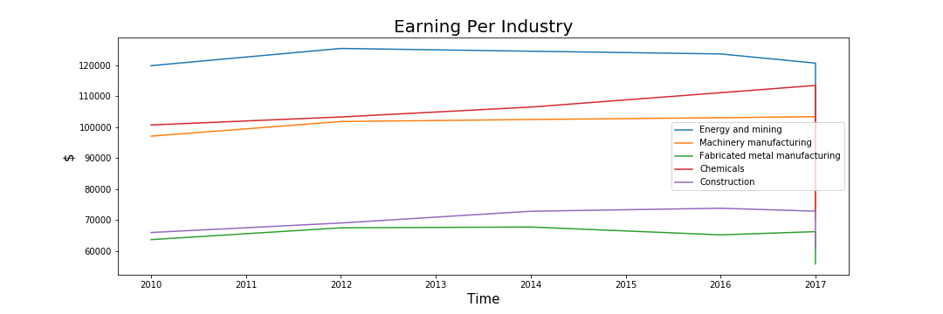
Project 1
Check Title / Y Legend placing, Utilities??
Decrease
Increase
It tells us that the unemployment rate and housing price are mostly dependent
The oil price fluctuation does not show any corresponding change in housing price and unemployability over the counties

Slide 14
Thank You for your time and patience !
Questions ???

